Slide 1



Intel WIT Project
Introduction and Getting Started
Galileo Gen. 2
July, 2015
Catherine Galvin
Ellen le Bas
Ciara Walsh

Slide 2
Equipment required (per person)
Part | Qty | Datasheet link
Photocell (LDR) | 1 | Click here
Temperature sensor | 1 | Click here
LCD screen | 1 | Click here
Pushbutton | 1 | Click here
LED | 1 | Click here
Resistor (220ohm) | 3 | Click here
Jumper Wires (pack) | 2 | Click here
Breadboard | 1 | Click here

Slide 3
Knowledge Assumptions
Computer concepts
CPU
Memory
I/O (interfaces)
Operating System
Machine code
Analog vs Digital
Coding concepts
Variables and constants
Read/write concepts
Arduino IDE
Connecting Galileo to Wi-Fi
Compiling and executing
Circuits
Electric current flow
Conductors / insulators
Circuit diagrams
Electronic Components
Resistors
LEDs
Breadboard

Slide 4
Setting up the sensors

Slide 5
Digital Read – LED Button Press
Project Name: LED Button Press(Instructor Lead)
Objective: Illuminate LED when button is pressed
Software Elements
pinMode()
digitalWrite()
digitalRead()
if / else
Components
Intel Galileo Board (Qty 1)
Breadboard (QTY1)
Jumper Wires
5mm LED (Qty 1)
Momentary Switch (Qty 1)
220 Ohm Resister (Qty1)
10k Ohm Resister (Qty1)

Slide 6
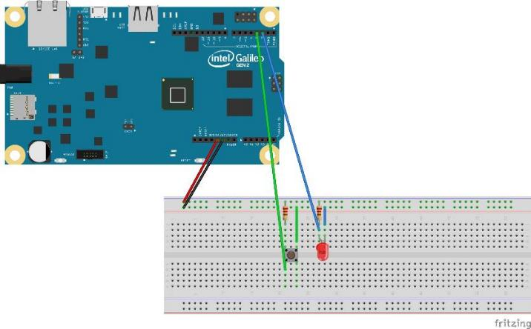
Digital Write – LED Button Press
// constants won't change, they're used here to set pin numbers:
const int button = 3; // the number of the pushbutton pin
const int led = 2; // the number of the LED pin
// variables will change:
int buttonState = 0; // variable for reading the pushbutton status
void setup() {
pinMode(led, OUTPUT); // initialize the LED pin as an output
pinMode(button, INPUT); // initialize the pushbutton pin as an input
}
void loop(){
buttonState = digitalRead(button); // read the state of the pushbutton value:
if (buttonState == LOW) { // if pressed:
digitalWrite(led, HIGH); // turn LED on:
}
else { //if not pressed
digitalWrite(led, LOW); // turn LED off:
}
}
* Other names and brands may be claimed as the property of others

Slide 7
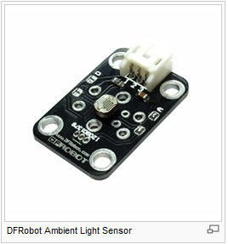
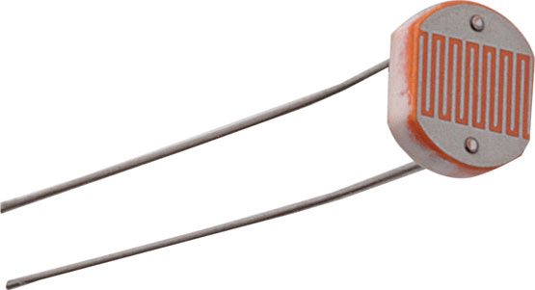
Light Sensing - Light Dependent Resistor (LDR)
An LDR is very similar to an ordinary resistor; it is made of a semi-conductive material that will partially restrict the flow of electricity through the device.
Variable resistor - proportional to how much light the LDR is exposed to.
Good enough for differentiating between light & dark
Notes:
However, ordinary resistors have a fixed value.
So when you buy a resistor with a value of 300 Ohms, that value is never going to change. That resistor will always have a resistance of 300 Ohms.

Slide 8
Light Sensing – Basic LDR
Project Name: LDR
Objective: read the value of an LDR connected to an analog pin, and print it out on the Serial port.
Software Elements
analogRead()
analogWrite()
Serial
delay()
Components
Intel Galileo Board (Qty 1)
Breadboard (QTY1)
Jumper Wires
5mm LED (Qty 1)
220 Ohm Resistor (Qty 2)
LDR (Qty 1)

Slide 9
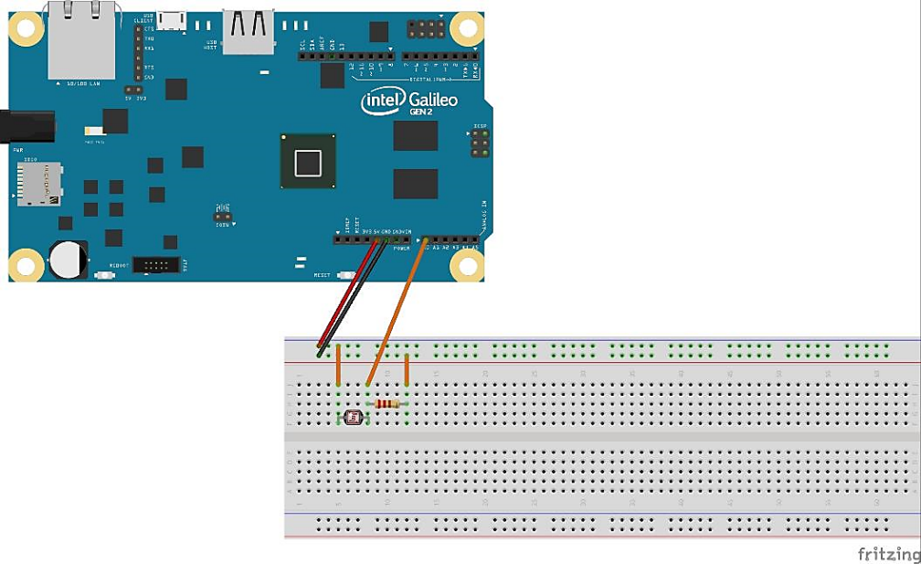
Light Sensing – Reading the LDR
#define LDR 0
int light_value; // variable for reading LDR
void setup() {
Serial.begin(115200); // set data rate
}
void loop() {
light_value = analogRead(LDR); // read value from ldr
if (light_value < 50) { // low value means lights are off
Serial.print("Lights are off\n");
delay(1000); // delay to avoid flickering
}
else { // high value means lights are on
Serial.print("Lights are on\n");
delay(1000); // delay to avoid flickering
}
}

Slide 10
Merging the two codes – LDR and Button
Objective: Press a pushbutton to check if lights are on and off and print it out on the Serial port.
LED is used to show when button is pressed
LDR code is added to pushbutton code as a function check_light
Software Elements
Pushbutton code
LDR code
Functions
Components
Intel Galileo Board
Breadboard w/ pushbutton setup
Jumper Wires
220 Ohm Resistor
LDR

Slide 11
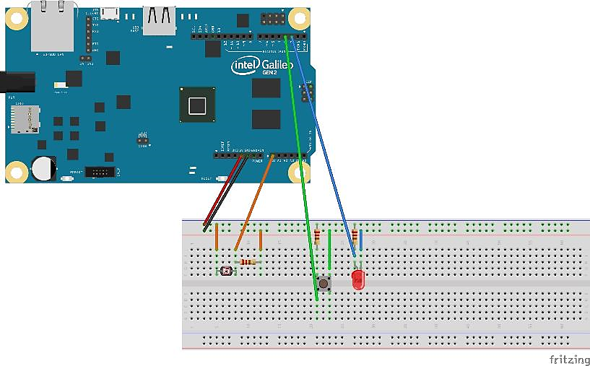
Merging the two codes – LDR and Button

Slide 12
Merging the two codes – LDR and Button
#define LDR 0
const int button = 3; // the number of the pushbutton pin
const int led = 2; // the number of the LED pin
int light_value; // variable for reading LDR
int buttonState = 0; // variable for reading the pushbutton status
void setup() {
pinMode(led, OUTPUT); // initialize the LED pin as an output
pinMode(button, INPUT); // initialize the pushbutton pin as an input
Serial.begin(115200); // set data rate at highest value needed
}
void loop(){
buttonState = digitalRead(button);// read the state of the pushbutton
if (buttonState == LOW) { // if pressed:
digitalWrite(led, HIGH); // turn LED on
check_light(); // check if lights are on/off and print to serial monitor
delay(500); // delay to avoid flickering
}
else { //if not pressed:
digitalWrite(led, LOW); // turn LED off
}
}
void check_light() { // function to check if lights are on/off and print to serial monitor
light_value = analogRead(LDR); //read value from ldr
if (light_value < 50) { // low value means lights are off
Serial.print("Lights are off\n");
}
else { // high value means lights are on
Serial.print("Lights are on\n");
}
}

Slide 13
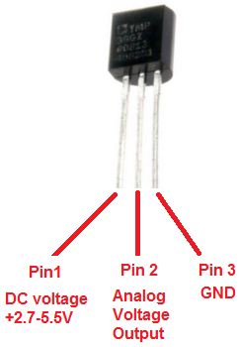
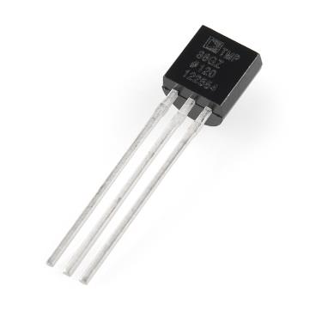
Temperature Sensor
Doesn't use mercury (like old thermometers), bimetallic strips (like in some home thermometers or stoves), nor thermistors (temperature sensitive resistors)
Uses the fact as temperature increases, the voltage across a diode increases at a known rate (solid-state technique)
Operating Range: −40°C to +125°C
±2°C accuracy over temperature
Notes:
However, ordinary resistors have a fixed value.
So when you buy a resistor with a value of 300 Ohms, that value is never going to change. That resistor will always have a resistance of 300 Ohms.

Slide 14
Basic Temperature Sensor
Project Name: Temperature Sensor
Objective: read the value of a temperature sensor connected to an analog pin, and print it out on the Serial port.
Software Elements
analogRead()
analogWrite()
Serial
delay()
Components
Intel Galileo Board
Breadboard
Jumper Wires
Temperature Sensor
Notes:
However, ordinary resistors have a fixed value.
So when you buy a resistor with a value of 300 Ohms, that value is never going to change. That resistor will always have a resistance of 300 Ohms.

Slide 15
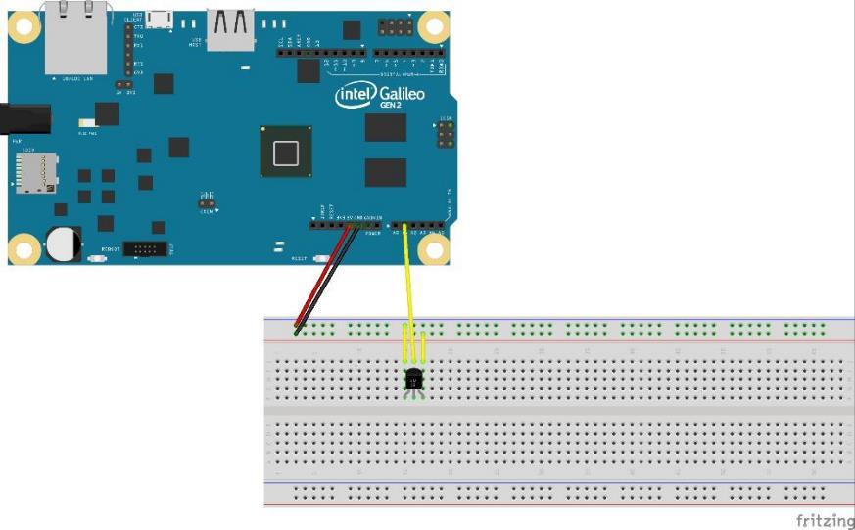
Reading the Temperature Sensor
#define temperature 1
int temperature_value; // variable for reading temperature sensor
float cel; // variable to calculate Celsius value
void setup()
{
Serial.begin(9600);
}
void loop()
{
temperature_value = analogRead(temperature); // check value from sensor
float mv = ( temperature_value / 1024.0) * 5000; // use value to calculate temperature
float farh = mv / 10;
cel = ((farh - 32) * 5) / 9; // convert temperature from Fahrenheit to Celsius
Serial.print("TEMPERATURE = "); // print temperature to serial monitor
Serial.print(cel);
Serial.print("*C\n");
delay(1000); // delay to avoid flickering
}

Slide 16
Adding Temperature Sensor to code
Objective: Press a pushbutton to check if lights are on and off and what temperature it is, and print it out on the Serial port.
LED is used to show when button is pressed
Temperature code is added to merged code as a function check_temp
Software Elements
Merged code
Temperature code
Functions
Components
Intel Galileo Board
Breadboard w/ pushbutton+LDR setup
Jumper Wires
Temperature Sensor

Slide 17
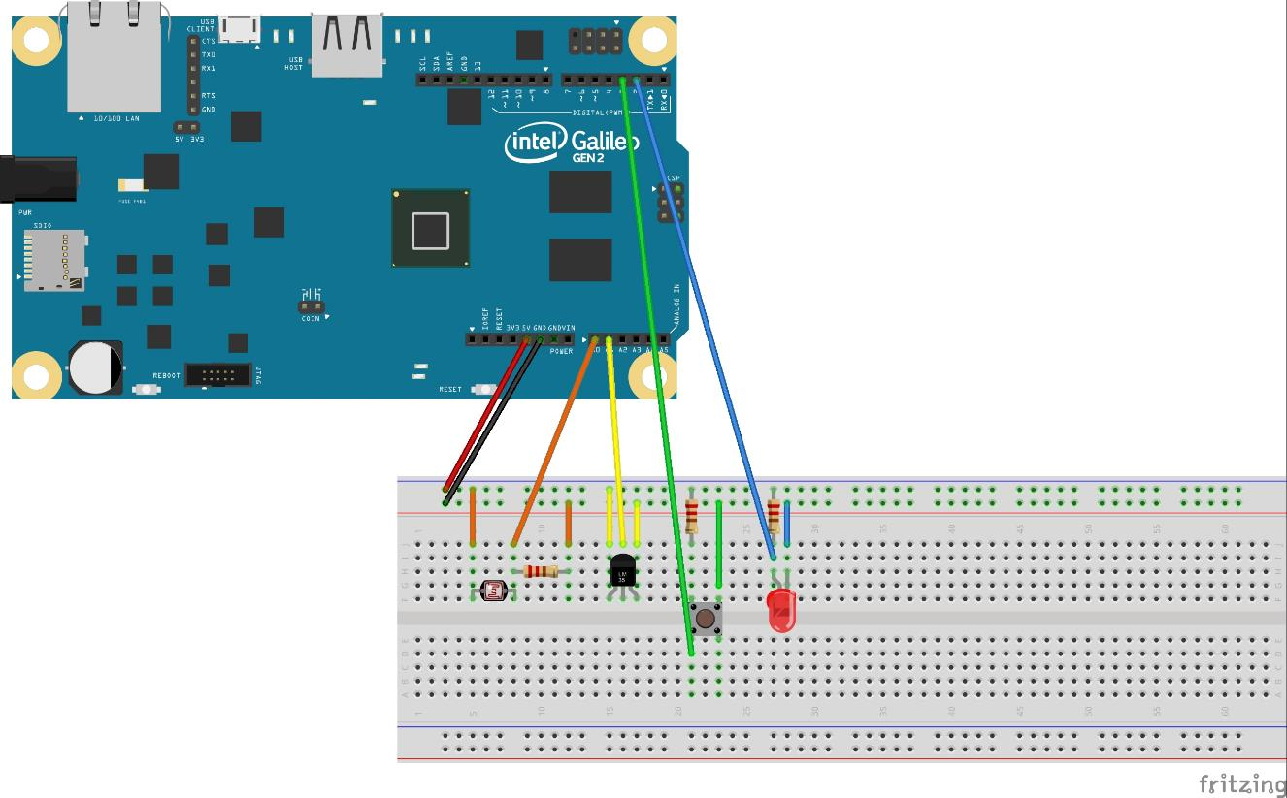
Combining LDR, Pushbutton & Temperature Sensor

Slide 18
Combining LDR, Pushbutton & Temperature Sensor
#define LDR 0
#define temperature 1
const int button = 3; // the number of the pushbutton pin
const int led = 2; // the number of the LED pin
int buttonState = 0; // variable for reading pushbutton status
int light_value; // variable for reading LDR
int temperature_value; // variable for reading temperature sensor
float cel; // variable to calculate celcius value
void setup() {
Serial.begin(115200); // set data rate at highest value needed
pinMode(led, OUTPUT); // initialize the LED pin as an output
pinMode(button, INPUT); // initialize the pushbutton pin as an input
}
void loop(){
buttonState=digitalRead(button);// read the state of the pushbutton
if (buttonState == LOW) { // if pressed:
digitalWrite(led, HIGH); // turn LED on
check_light(); // check if lights are on/off and print to serial monitor
check_temp(); // check the temperature
print_temp(); // print temperature to serial monitor
delay(500);
}
else { // if button isn’t pressed:
digitalWrite(led, LOW); // turn LED off
}
}

Slide 19
Combining LDR, Pushbutton & Temperature Sensor
void check_light() { // function to check if lights are on/off and print to serial monitor
light_value = analogRead(LDR); // read value from ldr
if (light_value < 50) { // low value means lights are off
Serial.print("Lights are off\n"); // print to serial monitor
}
else { // high value means lights are on
Serial.print("Lights are on\n"); // print to serial monitor
}
}
void check_temp() { // function to calculate temperature
temperature_value = analogRead(temperature); // check value from sensor
float mv = ( temperature_value / 1024.0) * 5000; // use value to calculate temperature
float farh = mv / 10;
cel = ((farh - 32) * 5) / 9; // convert temperature from Fahrenheit to Celsius
}
void print_temp() { // function to print temperature to serial monitor
Serial.print("TEMPERATURE = ");
Serial.print(cel);
Serial.print("*C\n");
}

Slide 20
Connecting to Twitter

Slide 21
Legal Disclaimer
INFORMATION IN THIS DOCUMENT IS PROVIDED IN CONNECTION WITH INTEL PRODUCTS. NO LICENSE, EXPRESS OR IMPLIED, BY ESTOPPEL OR OTHERWISE, TO ANY INTELLECTUAL PROPERTY RIGHTS IS GRANTED BY THIS DOCUMENT. EXCEPT AS PROVIDED IN INTEL'S TERMS AND CONDITIONS OF SALE FOR SUCH PRODUCTS, INTEL ASSUMES NO LIABILITY WHATSOEVER AND INTEL DISCLAIMS ANY EXPRESS OR IMPLIED WARRANTY, RELATING TO SALE AND/OR USE OF INTEL PRODUCTS INCLUDING LIABILITY OR WARRANTIES RELATING TO FITNESS FOR A PARTICULAR PURPOSE, MERCHANTABILITY, OR INFRINGEMENT OF ANY PATENT, COPYRIGHT OR OTHER INTELLECTUAL PROPERTY RIGHT.
A "Mission Critical Application" is any application in which failure of the Intel Product could result, directly or indirectly, in personal injury or death. SHOULD YOU PURCHASE OR USE INTEL'S PRODUCTS FOR ANY SUCH MISSION CRITICAL APPLICATION, YOU SHALL INDEMNIFY AND HOLD INTEL AND ITS SUBSIDIARIES, SUBCONTRACTORS AND AFFILIATES, AND THE DIRECTORS, OFFICERS, AND EMPLOYEES OF EACH, HARMLESS AGAINST ALL CLAIMS COSTS, DAMAGES, AND EXPENSES AND REASONABLE ATTORNEYS' FEES ARISING OUT OF, DIRECTLY OR INDIRECTLY, ANY CLAIM OF PRODUCT LIABILITY, PERSONAL INJURY, OR DEATH ARISING IN ANY WAY OUT OF SUCH MISSION CRITICAL APPLICATION, WHETHER OR NOT INTEL OR ITS SUBCONTRACTOR WAS NEGLIGENT IN THE DESIGN, MANUFACTURE, OR WARNING OF THE INTEL PRODUCT OR ANY OF ITS PARTS.
Intel may make changes to specifications and product descriptions at any time, without notice. Designers must not rely on the absence or characteristics of any features or instructions marked "reserved" or "undefined". Intel reserves these for future definition and shall have no responsibility whatsoever for conflicts or incompatibilities arising from future changes to them. The information here is subject to change without notice. Do not finalize a design with this information.
The products described in this document may contain design defects or errors known as errata which may cause the product to deviate from published specifications. Current characterized errata are available on request.
Contact your local Intel sales office or your distributor to obtain the latest specifications and before placing your product order.
Copies of documents which have an order number and are referenced in this document, or other Intel literature, may be obtained by calling 1-800-548-4725, or go to: http://www.intel.com/design/literature.htm%20 Performance tests and ratings are measured using specific computer systems and/or components and reflect the approximate performance of Intel products as measured by those tests. Any difference in system hardware or software design or configuration may affect actual performance. Buyers should consult other sources of information to evaluate the performance of systems or components they are considering purchasing. For more information on performance tests and on the performance of Intel products, visit Intel Performance Benchmark Limitations
All products, computer systems, dates and figures specified are preliminary based on current expectations, and are subject to change without notice.
Celeron, Intel, Intel logo, Intel Core, Intel Inside, Intel Inside logo, Intel. Leap ahead., Intel. Leap ahead. logo, Intel NetBurst, Intel SpeedStep, Intel XScale, Itanium, Pentium, Pentium Inside, VTune, Xeon, and Xeon Inside are trademarks or registered trademarks of Intel Corporation or its subsidiaries in the United States and other countries.
Intel® Active Management Technology requires the platform to have an Intel® AMT-enabled chipset, network hardware and software, as well as connection with a power source and a corporate network connection. With regard to notebooks, Intel AMT may not be available or certain capabilities may be limited over a host OS-based VPN or when connecting wirelessly, on battery power, sleeping, hibernating or powered off. For more information, see http://www.intel.com/technology/iamt.
64-bit computing on Intel architecture requires a computer system with a processor, chipset, BIOS, operating system, device drivers and applications enabled for Intel® 64 architecture. Performance will vary depending on your hardware and software configurations. Consult with your system vendor for more information.
No computer system can provide absolute security under all conditions. Intel® Trusted Execution Technology is a security technology under development by Intel and requires for operation a computer system with Intel® Virtualization Technology, an Intel Trusted Execution Technology-enabled processor, chipset, BIOS, Authenticated Code Modules, and an Intel or other compatible measured virtual machine monitor. In addition, Intel Trusted Execution Technology requires the system to contain a TPMv1.2 as defined by the Trusted Computing Group and specific software for some uses. See http://www.intel.com/technology/security/ for more information.
†Hyper-Threading Technology (HT Technology) requires a computer system with an Intel® Pentium® 4 Processor supporting HT Technology and an HT Technology-enabled chipset, BIOS, and operating system. Performance will vary depending on the specific hardware and software you use. See www.intel.com/products/ht/hyperthreading_more.htm for more information including details on which processors support HT Technology.
Intel® Virtualization Technology requires a computer system with an enabled Intel® processor, BIOS, virtual machine monitor (VMM) and, for some uses, certain platform software enabled for it. Functionality, performance or other benefits will vary depending on hardware and software configurations and may require a BIOS update. Software applications may not be compatible with all operating systems. Please check with your application vendor.
* Other names and brands may be claimed as the property of others.
Other vendors are listed by Intel as a convenience to Intel's general customer base, but Intel does not make any representations or warranties whatsoever regarding quality, reliability, functionality, or compatibility of these devices. This list and/or these devices may be subject to change without notice.
Copyright © 2014, Intel Corporation. All rights reserved.

